Slide 1
Aggregating Atomic Clocks for Time-Stamps (for Internet of Things (IoT), Blockchain, and Beyond)
Jeffrey Voas
j.voas@ieee.org
Jeff.voas@nist.gov

Slide 2
Problem #1 – IoT “precision time snapshots”

Slide 3
To Begin
No universally-accepted and actionable definition existed to the question, “What is IoT?”
And no good definition of trust exists for IoT.

Slide 4
“The term Internet of Things generally refers to scenarios where network connectivity and computing capability extends to objects, sensors and everyday items not normally considered computers, allowing these devices to generate, exchange and consume data with minimal human intervention.”
The Internet of Things (IoT): An Overview, Karen Rose, et.al. The Internet Society, October 2015. p. 5.
“Although there is no single definition for the Internet of Things, competing visions agree that it relates to the integration of the physical world with the virtual world – with any object having the potential to be connected to the Internet via short-range wireless technologies, such as radio frequency identification (RFID), near field communication (NFC), or wireless sensor networks (WSNs). This merging of the physical and virtual worlds is intended to increase instrumentation, tracking, and measurement of both natural and social processes.”
“Algorithmic Discrimination: Big Data Analytics and the Future of the Internet”, Jenifer Winter. In: The Future Internet: Alternative Visions. Jenifer Winter and Ryota Ono, eds. Springer, December 2015. p. 127.

Slide 5
“Industrial Internet of Things (IOT) is a distributed network of smart sensors that enables precise control and monitoring of complex processes over arbitrary distances.”
“Ensuring trust and security in the industrial IoT”, Bernardo A. Huberman. Ubiquity: An ACM Publication, January 2016, p. 1.
“The concept of Internet of Things (IOT) … is that every object in the Internet infrastructure is interconnected into a global dynamic expanding network.”
“An efficient user authentication and key agreement scheme for heterogeneous wireless sensor network tailored for the Internet of Things environment”, Mohammad Sabzinejad Farasha, et.al. Ad Hoc Networks 36(1), January 2016.
“In what’s called the Internet of Things, sensors and actuators embedded in physical objects—from roadways to pacemakers—are linked through wired and wireless networks, often using the same Internet Protocol (IP) that connects the Internet.”
“The Internet of things”, M. Chui, M. Löffler, and R. Roberts. McKinsey Quarterly,
Sept. 23, 2015. As cited in: “Control Systems and the Internet of Things”, Tariq Samad. IEEE Control Systems Magazine, 36(1), February 2016. p. 14.

Slide 6
“Smart”?
Is the definition of IoT simply any noun you can attach “smart” onto?
Smart phone, smart car, smart appliance, smart toy, smart home, smart watch, smart grid, smart city, smart tv, smart suitcase, smart clothes, ….

Slide 7
Take Away Points
Having no accepted IoT definition means no justifiable Trust – claims of trust will therefore employ “handwaving.”
Trust requires a bounded problem.

Slide 8
Opening Statement
We stepped back from the acronym (I) (o) (T)
Why?
(o) does not matter;
(I) existed long before IoT was coined so (I) is not very useful;
So maybe it is the (T)s that matter?
We opted for the acronym NoT: Network of ‘Things’
Network of ‘Things’ employs a mixture of sensing, communication, computation, actuation.

Slide 9
Cyber Physical Systems (CPS) vs. IoT
Cyber = Internet?
Physical = Things?

Slide 10
http://nvlpubs.nist.gov/nistpubs/SpecialPublications/NIST.SP.800-183.pdf

Slide 11
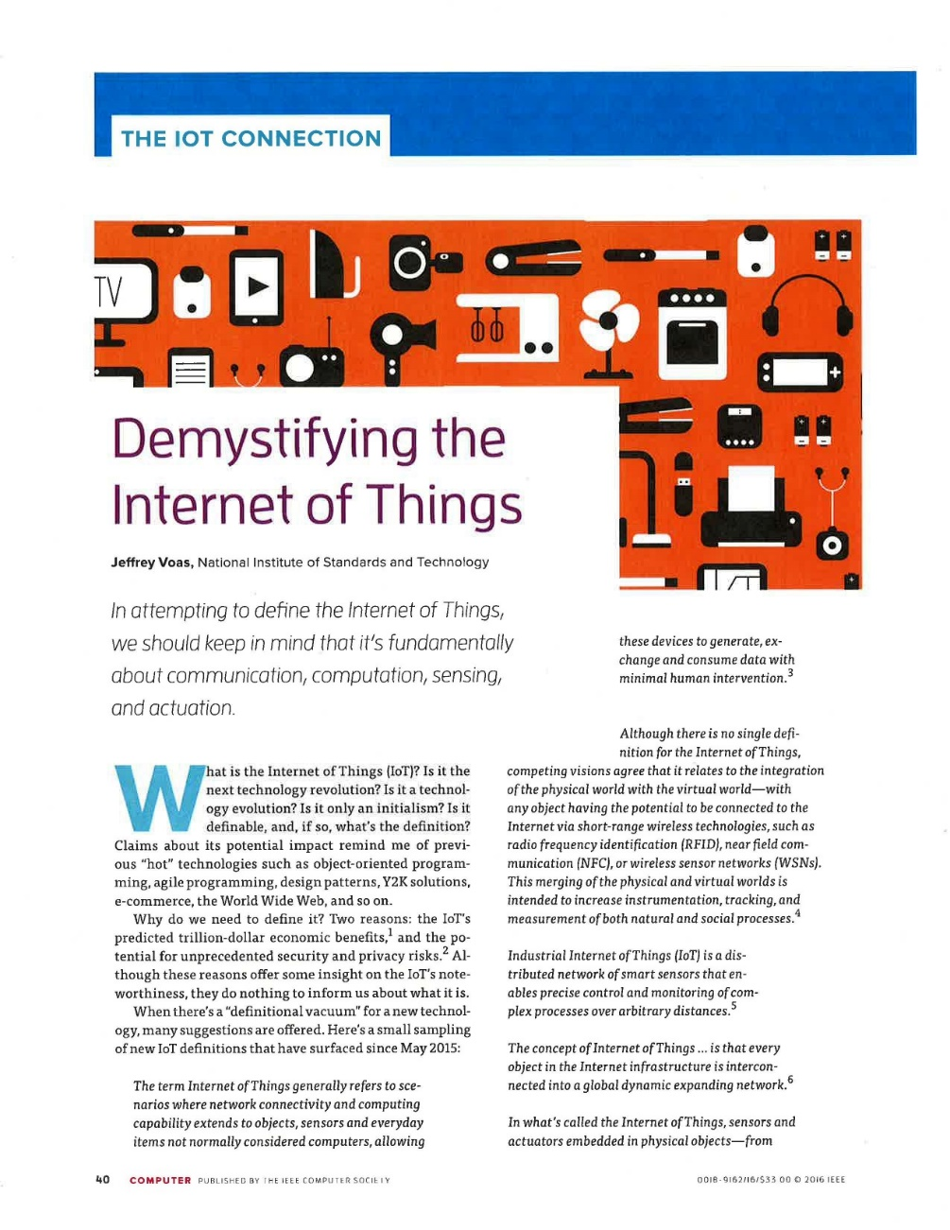
Goal of 800-183: Explain What One Viewpoint of What IoT Might Be

Slide 12
Rationale
It is easier to discuss a purposed NoT than “an IoT.”
Do you actually have “an IoT”? If so, can I compare your IoT to my IoT? No! Why? The Internet is not measurable and bounded. (IoT metrology)
In contrast, a NoT can be measured, bounded, and compared.

Slide 13
Primitives – the ‘Things’ (Categories of building blocks. Similar to pieces of Lego®)
Sensor A sensor is an electronic utility that measures physical properties such as temperature, acceleration, weight, sound, location, presence, identity, etc. All sensors employ mechanical, electrical, chemical, optical, or other effects at an interface to a controlled process or open environment
Aggregator An aggregator is a software implementation based on mathematical function(s) that transforms groups of raw data into intermediate, aggregated data. Raw data can come from any source. Aggregators address ‘big’ data.
Communication channel A communication channel is a medium by which data is transmitted (e.g., physical via USB, wireless, wired, verbal, etc.).
eUtility An eUtility (external utility) is a software or hardware product, or service.
Decision trigger A decision trigger creates the final output(s) needed to satisfy the purpose, specification, and requirements of a specific NoT.

Slide 14
For each Primitive, We Discuss ….
“Basic properties, assumptions, recommendations, and general statements about Primitive x include:”
Such information offers clues into what IoT might be about and trust concerns.

Slide 15
1. Sensor (8 of 29)
Sensors may be heterogeneous, from different manufacturers, and collect data, with varying levels of data integrity.
Sensors may be associated with fixed geographic locations or may be mobile.
Sensors may have an owner(s) who will have control of the data their sensors collect, who is allowed to access it, and when.
Sensors will have pedigree – geographic locations of origin and manufacturers. Pedigree may be unknown, and suspect.
Sensors may be cheap, disposable, and susceptible to wear-out over time.
There will differentials in sensor security, safety, and reliability, e.g., between consumer grade, military grade, industrial grade, etc.
Sensors may return no data, totally flawed data, partially flawed data, or correct/acceptable data. Sensors may fail completely or intermittently. They may lose sensitivity or calibration.
Security is a concern for sensors if they or their data is tampered with, stolen, deleted, dropped, or transmitted insecurely so it can be accessed by unauthorized parties. Building security into specific sensors may or may not be cost effective.

Slide 16
2. Aggregator (4 of 11)
Intermediate, aggregated data may suffer from some level of information loss. Proper care in the aggregation process should be given to significant digits, rounding, averaging, and other arithmetic operations to avoid unnecessary loss of precision.
Aggregators may be acquired off-the-shelf. Note that aggregators may be non-existent and will need to be home-grown. This may create a problem for huge volumes of data within a NoT.
Security is a concern for aggregators (malware or general defects) and for the sensitivity of their aggregated data. Further, aggregators could be attacked, e.g., by denying them the ability to operate/execute or by feeding them bogus data.
Reliability is a concern for aggregators (general defects).

Slide 17
3. Communication Channel (6 of 12)
Communication channels move data between computing, sensing, and actuation.
Since data is the “blood” of a NoT, communication channels are the “veins” and “arteries”, as data moves to and from intermediate events at different snapshots in time.
Communication channels will have a physical or virtual aspect to them, or both. Protocols and associated implementations provide a virtual dimension, cables provide a physical dimension.
No standardized communication channel protocol is assumed; a specific NoT may have multiple communication protocols between different entities.
Communication channels are prone to disturbances and interruptions.
Redundancy can improve communication channel reliability. There may be more than one distinct communication channel between a computing primitive and a sensing primitive.

Slide 19
4. eUtility (4 of 9)
eUtilities include databases, mobile devices, misc. software or hardware systems, clouds, computers, CPUs, actuators, etc.
eUtilities will likely be acquired off-the-shelf from 3rd parties.
eUtilities, such as clouds, provide computing power that aggregators may not have.
A human may be viewed as a eUtility. A human is sometimes referred to as a ‘thing’ in public IoT discourse.

Slide 20
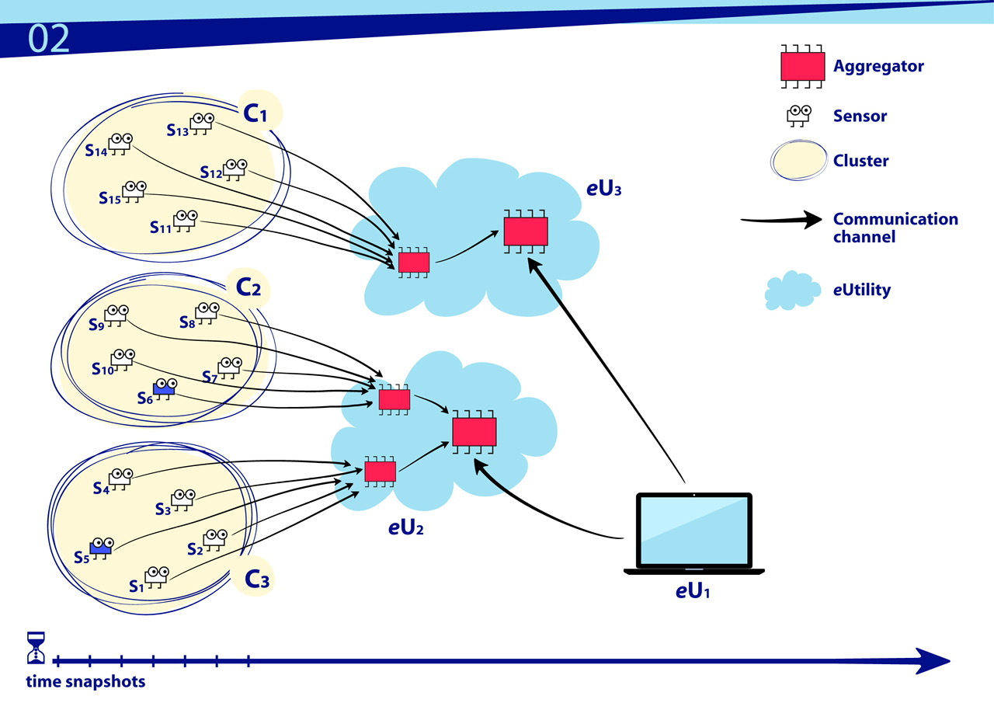

Slide 21
5. Decision trigger (6 of 19)
A decision trigger is a conditional expression that triggers an action. A decision trigger’s outputs control actuators and transactions. Decision triggers abstractly define the end purpose (specification) of a NoT.
It is fair to consider a decision trigger as an if-then rule.
A decision trigger may have a unique owner.
Decision triggers may be acquired off-the-shelf or homegrown.
Decision triggers are executed at specific times and may execute continuously as new data becomes available.
Failure to execute decision triggers at time t_{x} may occur due to tardy data collection, inhibited sensors or eUtilities, inhibited communication channels, low performance aggregators, and a variety of other subsystem failure modes

Slide 22
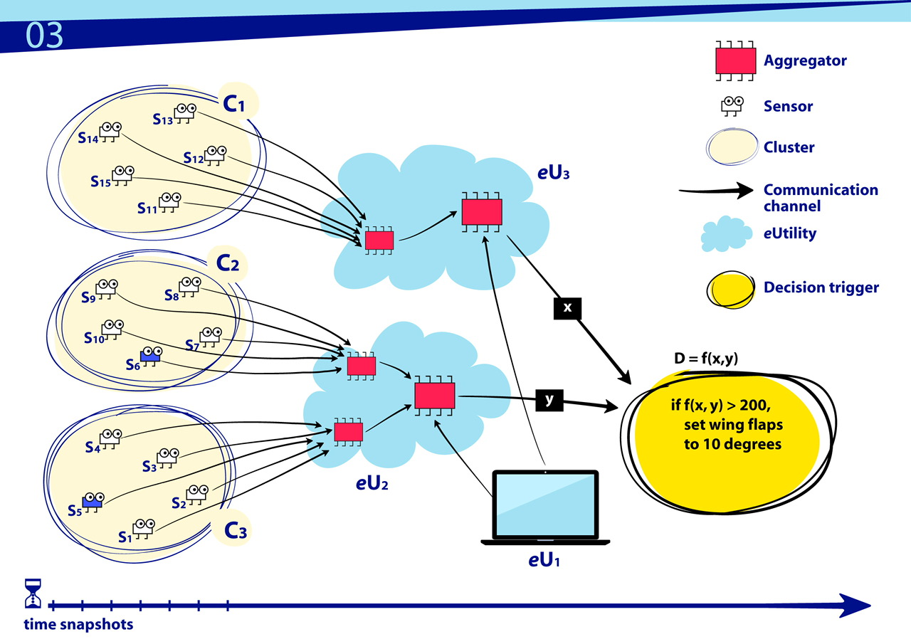

Slide 23
Actuators
All primitives are ‘things’
Not all ‘things’ are primitives
An actuator is a ‘thing’
A NoT is a distributed computing system
Primitives are the building blocks of a purposed NoT
An actuator is not a primitive – it only receives the output of a NoT and executes accordingly (there is one caveat here).
In the previous slide, the decision trigger is not the actuator on the wing flap but instead sends input to the flap
These points are subtle but differentiate the concept of a NoT from Cyber-Physical Systems (CPS)

Slide 24
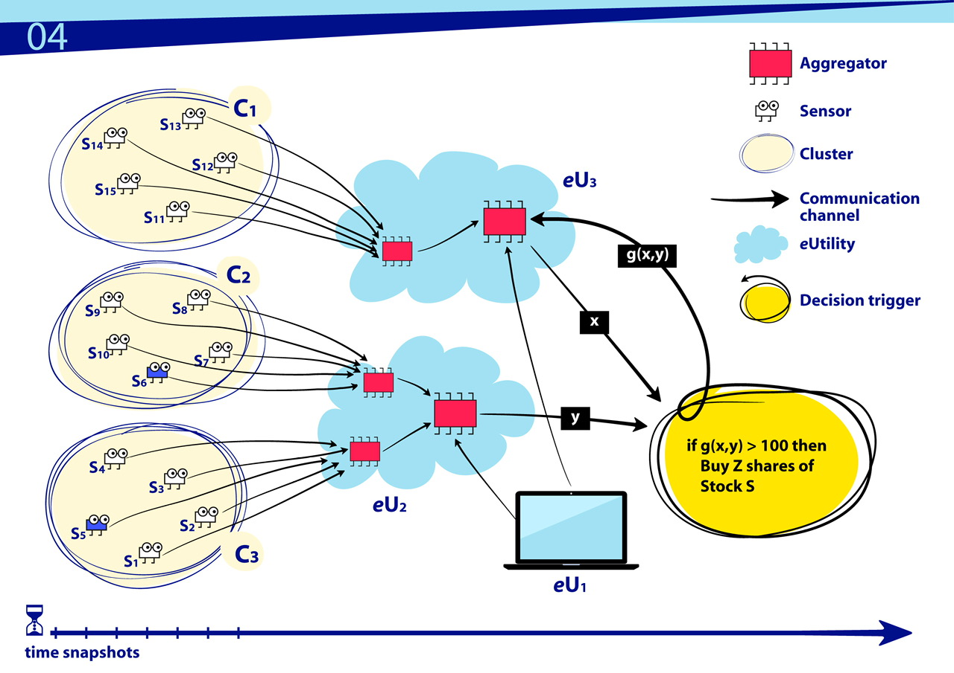

Slide 25
Artificial Pancreas

Slide 26
Pitfalls

Slide 27
So How Do the 5 Apply Here?
Probably only 4 do:
Sensor
Communication channel (wireless)
e-utility (cpu, software), and there is an actuator
Decision trigger
Aggregator may not apply – it is an unknown

Slide 28
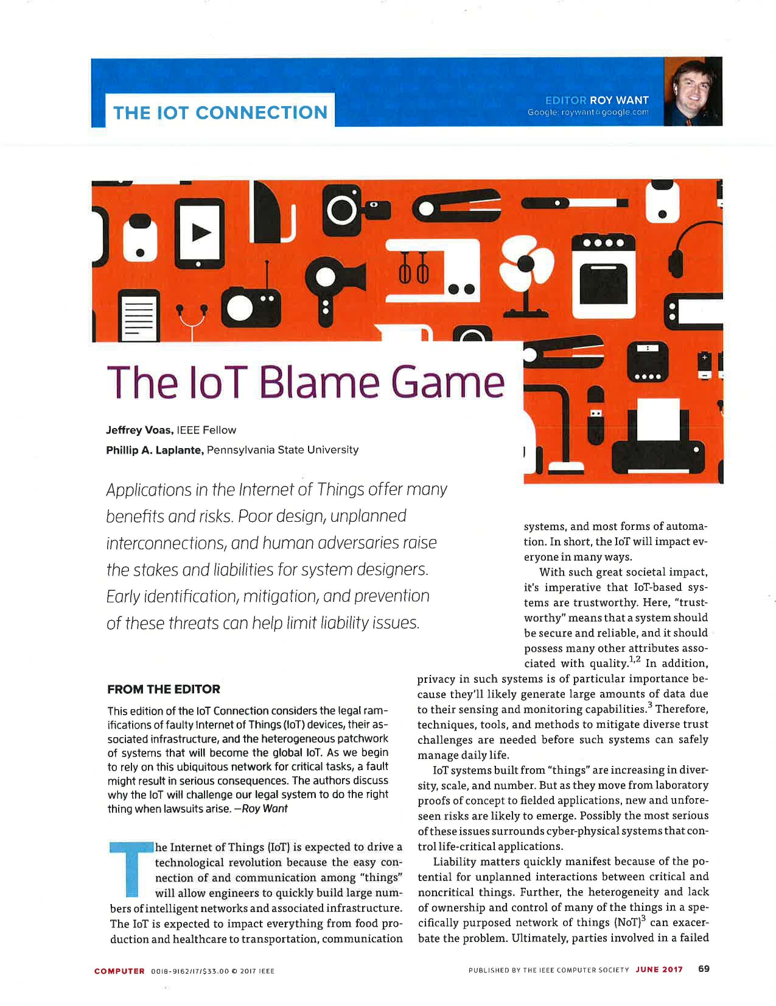
Liability

Slide 29
IoT Virtual Assistants

Slide 30
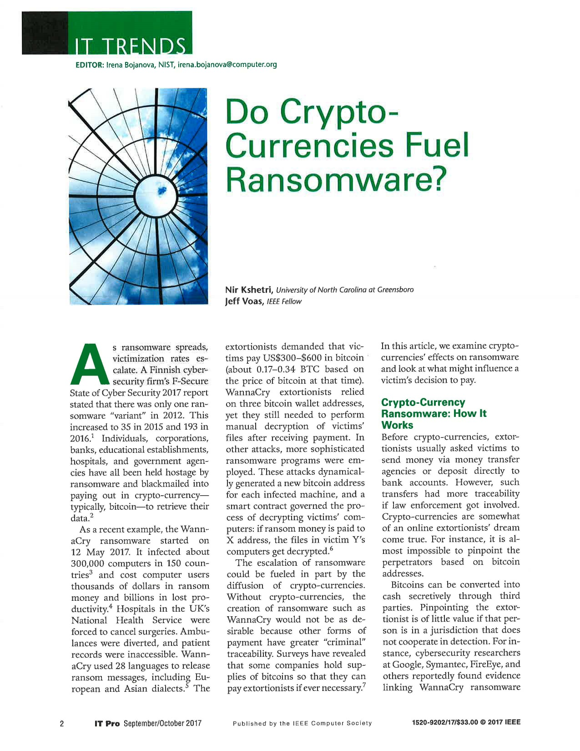
Ransomware ‘Things’?

Slide 31
July 2018
IEEE Computer Magazine

Slide 32
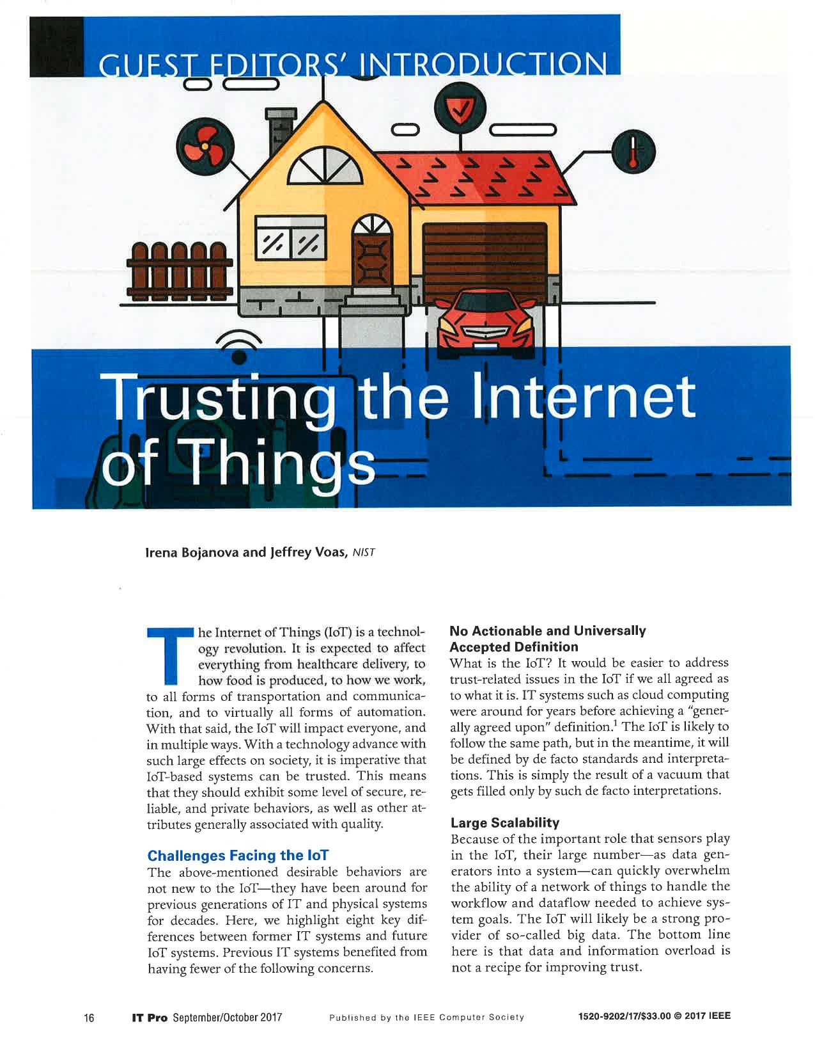
Trust Issues

Slide 33
IoT Trustworthiness – 6 Concerns
Environment – The universe that all primitives in a specific NoT operate in; this is essentially the operational profile of a NoT. The environment is particularly important to the sensor and aggregator primitives since it offers context to them. An analogy is the various weather profiles that an aircraft operates in or a particular factory setting that a NoT operates in. This will likely be difficult to correctly define.
Cost – The expenses, in terms of time and money, that a specific NoT incurs in terms of the non-mitigated reliability and security risks; additionally, the costs associated with each of the primitive components needed to build and operate a NoT. Cost is an estimation or prediction that can be measured or approximated. Cost drives the design decisions in building a NoT.
Geographic location – Physical place where a sensor or eUtility operates in or was manufactured, e.g., using RFID. Manufacturing location is a supply chain issue. Note that the operating location may change over time. Note that a sensor’s or eUtility’s geographic location along with communication channel reliability and data security may affect the dataflow throughout a NoT’s workflow in a timely manner. Geographic location determinations may sometimes not be possible.

Slide 34
Owner - Person or Organization that owns a particular sensor, communication channel, aggregator, decision trigger, or eUtility. There can be multiple owners for any of these five. Note that owners may have nefarious intentions that affect overall trust. Note further that owners may remain anonymous. Note that there is also a role for an operator; for simplicity, we roll up that role into the owner element.
Device_ID – A unique identifier for a particular sensor, communication channel, aggregator, decision trigger, or eUtility. Further, a Device_ID may be the only sensor data transmitted. This will typically originate from the manufacturer of the entity, but it could be modified or forged. This can be accomplished using RFID for physical primitives. RFID readers that work on the same protocol as the inlay may be distributed at key points throughout a NoT. Readers activate the tag causing it to broadcast radio waves within bandwidths reserved for RFID usage by individual governments internationally. These radio waves transmit identifiers or codes that reference unique information associated with the item to which the RFID inlay is attached, and in this case, the item would be a primitive.
Snapshot – an instant in time

Slide 35
Special Element: Snapshot
Because a NoT is a distributed system, different events, data transfers, and computations occur at different snapshots.
Snapshots may be aligned to a clock synchronized within their own network. A global clock may be too burdensome for sensor networks that operate in the wild. Others, however, argue in favor of a global clock [Li 2004]. This publication does not endorse either scheme at the time of this writing.
NoTs may affect business performance – sensing, communicating, and computing can speed-up or slow-down a NoT’s workflow and therefore affect the “perceived” performance of the environment it operates in or controls.
Snapshots maybe tampered with, making it unclear when events actually occurred, not by changing time (which is not possible), but by changing the recorded time at which an event in the workflow is generated, or computation is performed, e.g., sticking in a delay() function call.
Malicious latency to induce delays, are possible and will affect when decision triggers are able to execute.
Reliability and performance of a NoT may be affected by (d) and (e).

Slide 36
So the Issue is….?
Faking time in a Network of Things
How?
No global clock

Slide 37
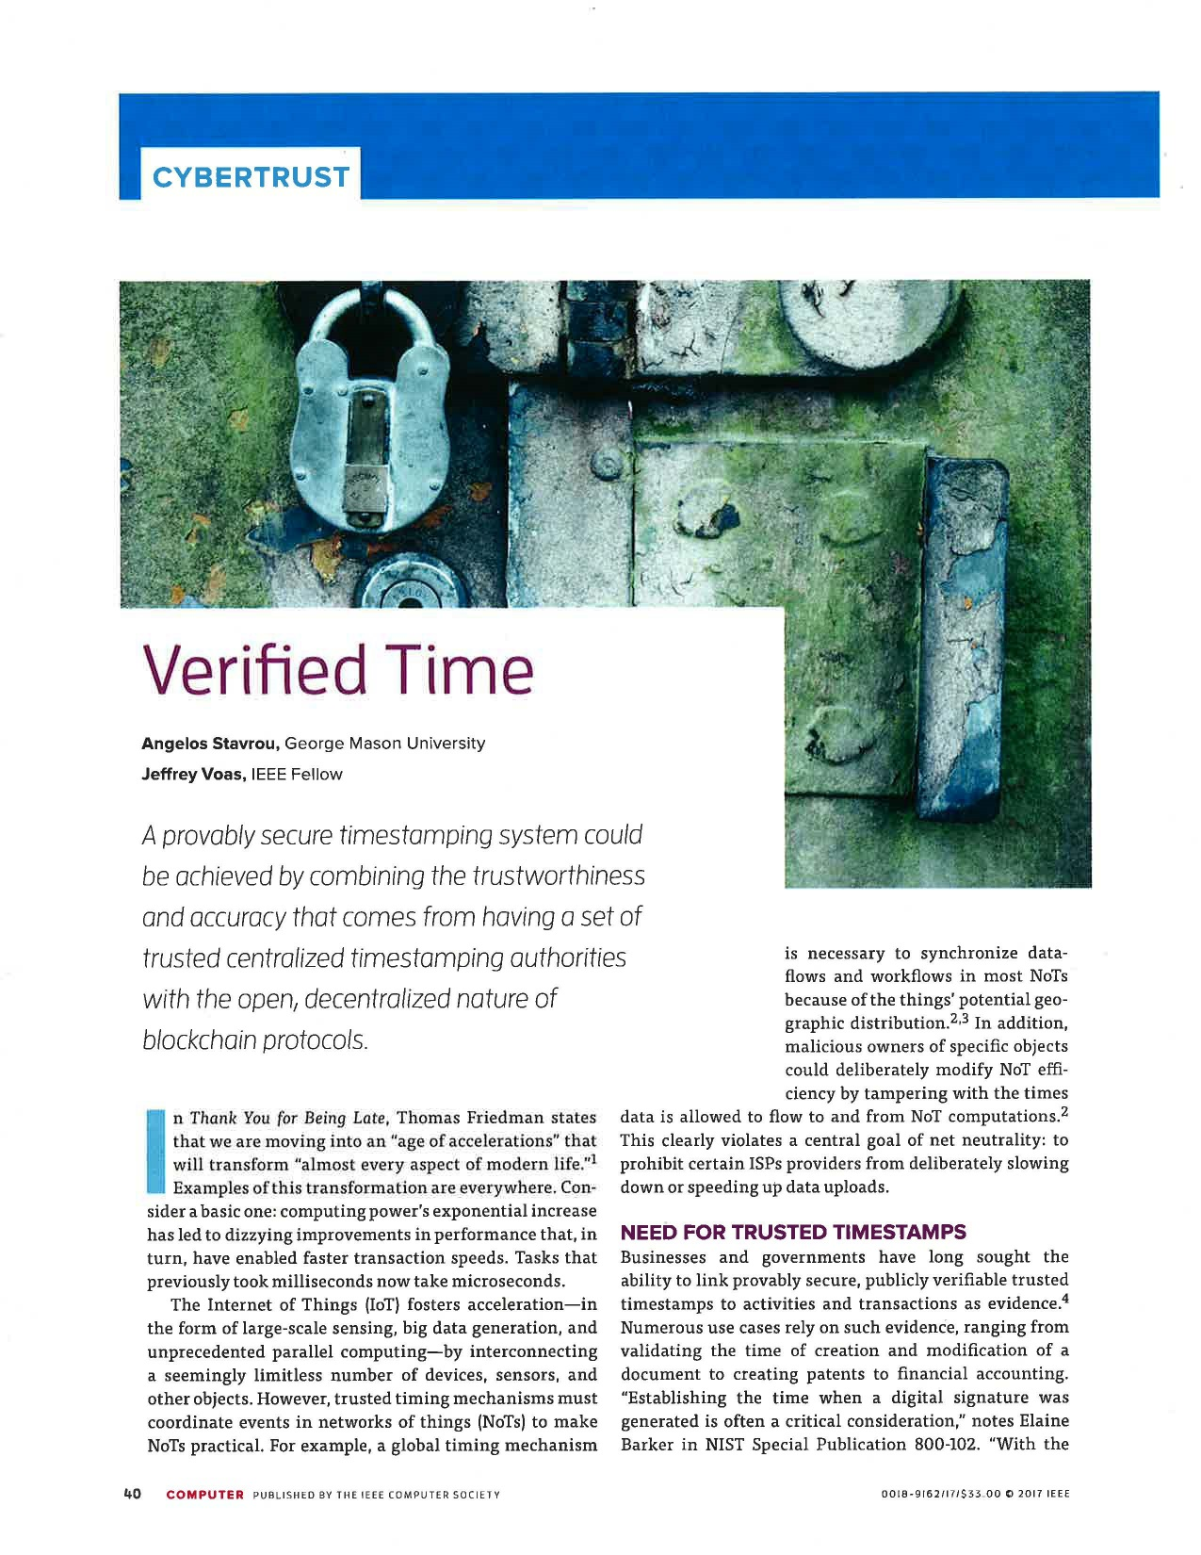

Slide 38
Problem #2 – Blockchain Race Conditions

Slide 39
Basic Concern
Some number of candidate blocks are currently undergoing mining (proof of work) to be the next addition to the chain.
A race is on.
They are mined based on the last block added.
Some block X will win the race – is it necessarily the one that should? No.
Mining based on “sequenced timestamps” *might* be a better solution.

Slide 40
Basic Clock Aggregation Idea
Let’s begin with a simple example: some event (or transaction) X wants to know precisely what time it is (we call this precise time value Exact Time (ET)). For simplicity, in our following illustrations, this request occurs between Noon and 1PM.
ET is a numerical value.
X can never know ET (precisely).

Slide 41
Figure 1
Event X
X wishes to know ET
Noon
Exact time
(ET)
1 PM

Slide 42
Timestamping Authority (TsA)
The general approach is to create a service termed as a Timestamping Authority (TsA)
The rationale for having a Timestamping Authority (TsA) is to offer any event or transaction X the ability to trust “some entity” that will return to it an approximation of ET.
Therefore in our example, X will make a call to a TsA to get an ET approximation.

Slide 43
Figure 2
Timestamping Authority (TsA)
Request is sent
Event X

Slide 44
Technical Approach
Use N > 1 atomic clocks to approximate ET.
N is arbitrary.
Many atomic clocks exist that can be selected from (apparently 400+).
A TsA will send a message to each clock requesting a time value.
In this effort, N = 3.

Slide 45
Figure 3
A₁
A₂
A₃
request
request
request
Timestamping Authority (TsA)

Slide 46
Over 400 atomic clocks around the world are used in calculation of Universal Coordinated Time (UTC)
International Bureau of Weights and Measures

Slide 47
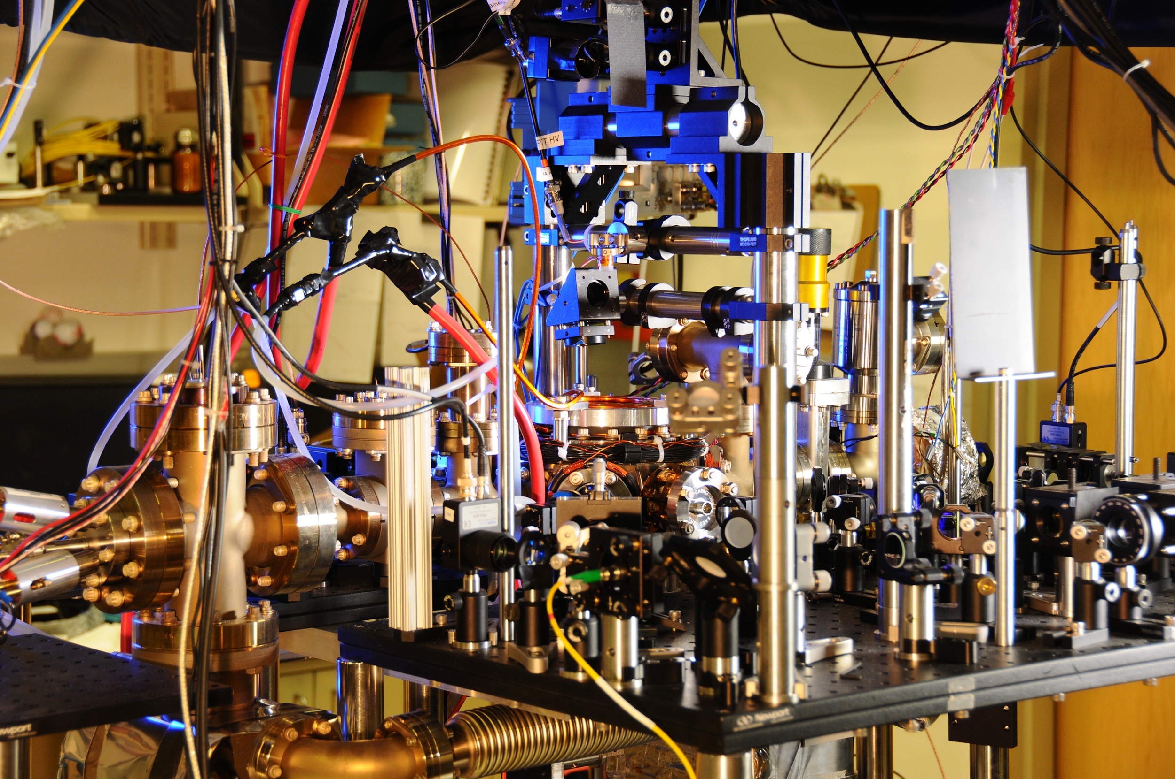
Atomic Clock

Slide 48
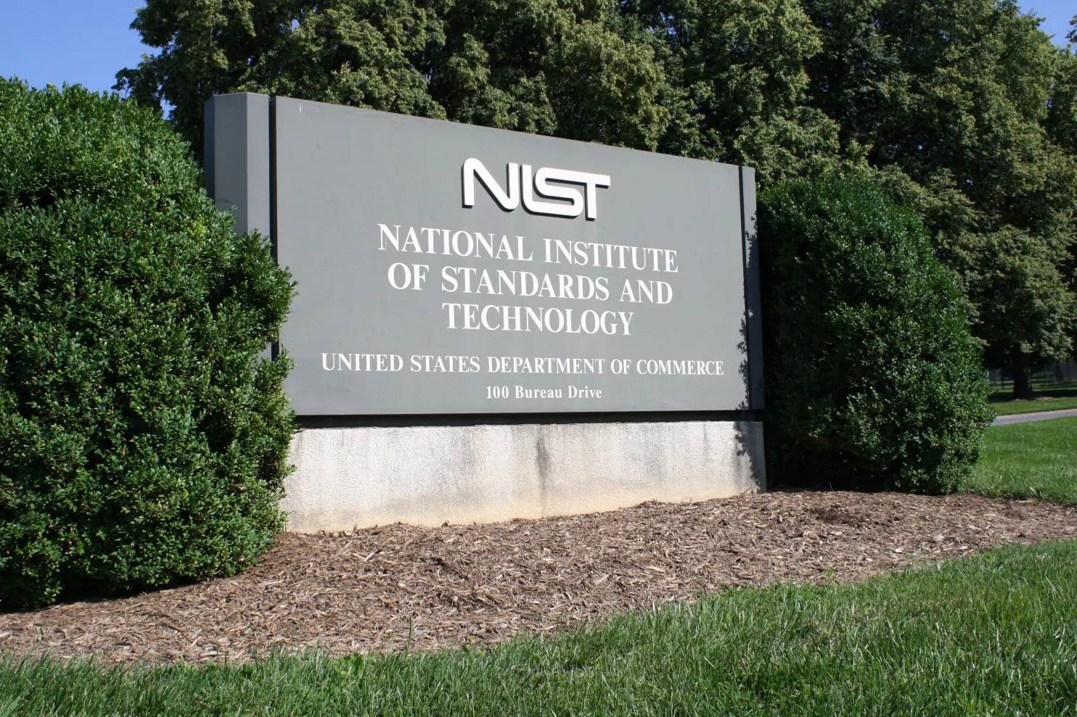
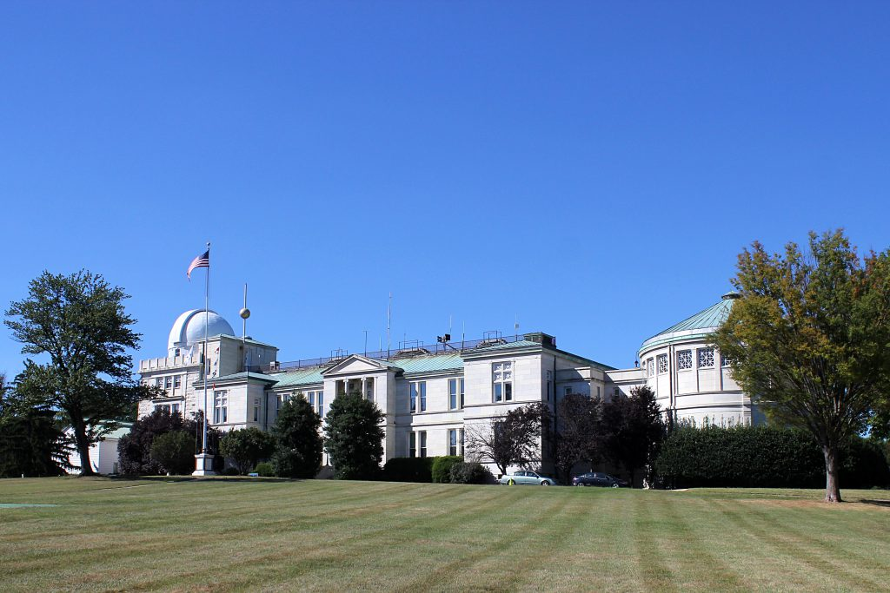
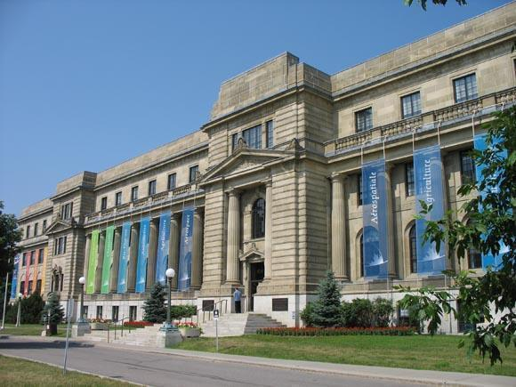
Clocks Used
NIST, Gaithersburg, USA
US Naval Observatory, Washington, DC, USA
National Research Council, Ottawa, Canada

Slide 49
Time Latencies
Latencies are the time used to send and receive messages. They may not be precisely known and can be gamed (in order to appear smaller than they are).
All requests in this effort had to deal with time latencies since requests are communications.

Slide 50
Partial Solution to Time Latencies
Clocks are very sensitive to denial of service attacks (ping of death)
Clocks will shut you down if they think you are attacking them.
Clocks are not willing to receive your request too often (NIST clock was 4 seconds). That was not quite frequent enough for us.
So we kept a “local” atomic clock on our computer (basic desktop PC) that turned out to be accurate enough for our goal – 10 milliseconds.
This approach lessened the latencies.
And we learned to use in geographic proximity. (We used 3 from North America) – this was an interesting lesson.

Slide 51
Figure 4
A₁
A₂
A₃
L₃
L₄
L₅
L₂
Timestamping Authority (TsA)
L₁
Event X

Slide 52
Approximate Exact Time
The final output (goal) is to return to X a time value that we term AET (Approximate Exact Time).
AET is a numerical value (just as is ET).
AET is a function f(w1, w2, w3, L1, L2, L3, L4, L5, value returned from A1, value returned from A2, value returned from A3).
w1 is a weighted trust in A1; w2 is a weighted trust in A2; w3 is a weighted trust in A3; w1, w2, w3 are selected by X.
w1 + w2 + w3 = 1.0
A1, A2, A3 are also selected by X.
f is a formula for how AET is calculated. There are probably limitless ways to calculate f. f is an aggregator.

Slide 53
Additional Latencies to Consider
There are additional latencies induced before returning AET to X, however these will not change the value of AET. They simply delay returning AET back to X.
They are L6, L7, L8, L9, and L10 (See Figure 5a, 5b).
So the time at which X receives AET will be a function g(L6, L7, L8, L9, L10).
Note that L9 is the processing time to compute f. L9 is likely the largest of all 10 latencies.
AET > ET due to {L1, L2, L3, L4, L5}.
The time at which AET is returned will be greater than AET due to {L6, L7, L8, L9, L10}.

Slide 54
Figure 5a
A₁
A₂
A₃
L₆
Return value
L₇
Return value
L₈
Return value
Timestamping Authority (TsA)
L₉
Processing time
L₁₀
Return AET value
Event X
Noon
ET
1 PM

Slide 55
Figure 5b
A₁
A₂
A₃
L₆
Return value
L₇
Return value
L₈
Return value
Timestamping Authority (TsA)
L₉
Processing time
L₁₀
Return AET value
Event X
Noon
ET
AET
1 PM

Slide 56
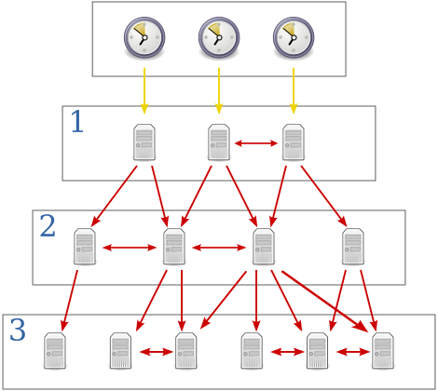
Network Time Protocol (NTP)

Slide 57
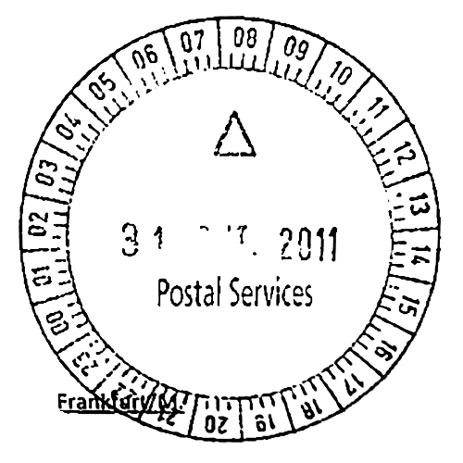
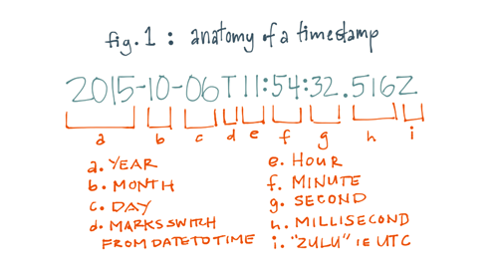
Timestamping

Slide 58
Order Preservation
 | Event 1 | Event 2
Real timestamp | 100 | 101
Acceptable timestamp | 100 | 100
Wrong timestamp | 101 | 100

Slide 59
Timestamping Authority (TsA)

Slide 60
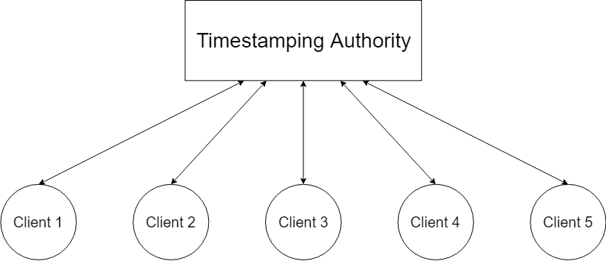
Single TsA?

Slide 61
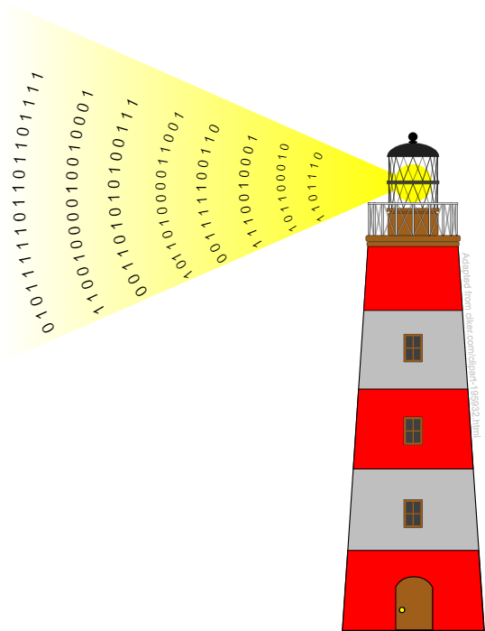
Chainpoint
Chainpoint.org
NIST Randomness Beacon
Blockchain
$$Chainpoint Proof: \left(Timestamp+hash(purely random bits)\right)→Blockchain$$

Slide 62
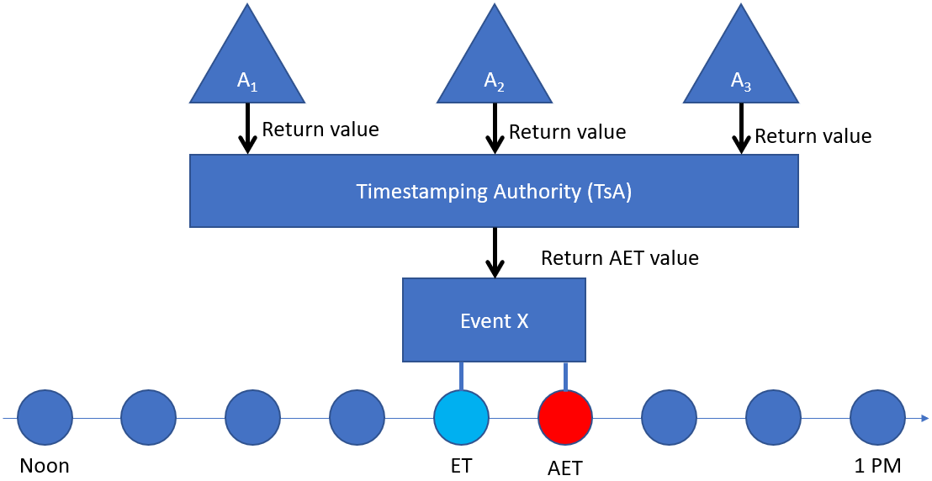
Atomic Clock Aggregation

Slide 63
Client-server Timings
Client
Server
Local time offset calculation

Slide 64
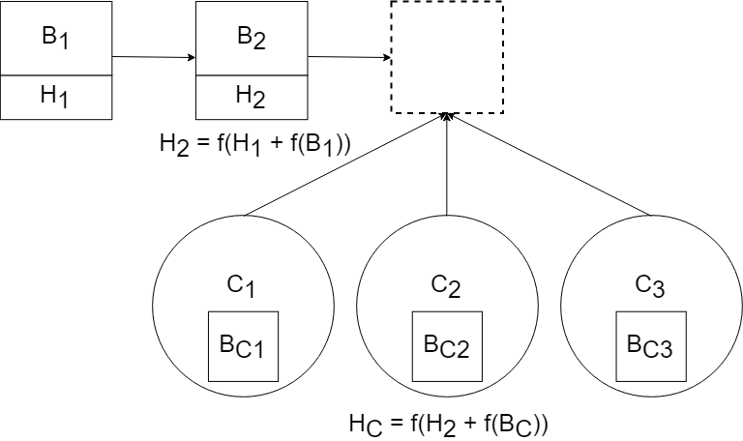
Application to Blockchain (Before)
The winner goes in
Others have to recalculate

Slide 65
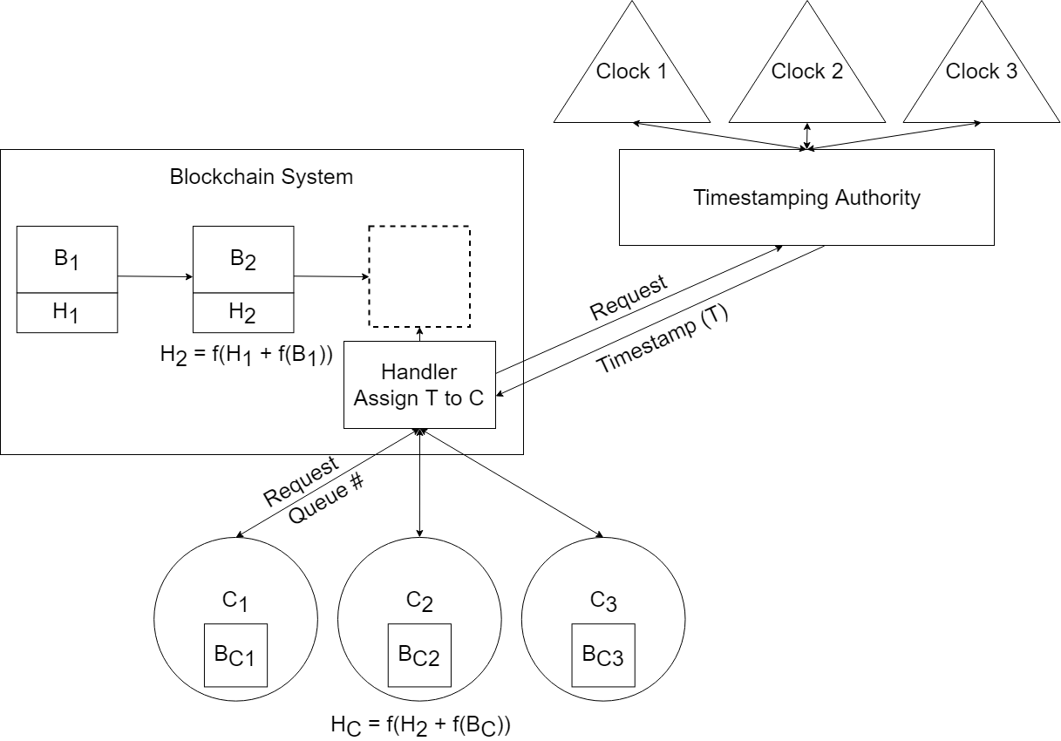
Application to Blockchain (After)
Each client is assigned a Queue #
First in the queue gets some time to finish the calculation
Others don’t waste resources

Slide 66
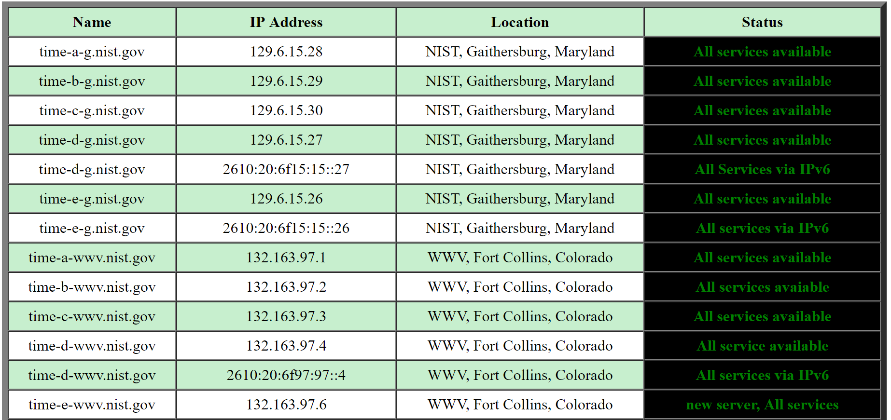
Implementation Description - github
Public NTP servers available
Code in Java
Update every 10 seconds

Slide 67
Final Thoughts
Real estate is about location, location, location
Computing is about timing, timing, timing
This simple effort showed that aggregated atomic clocks can benefit blockchain and IoT to offer better estimates to answer the question “what time is it?”
And finally, if this idea has practical merit (versus research/academic merit), would aggregating low-level aggregations (like the ones discussed here) provide something like a “universal” clock? (research is needed here)

